Slide 1
Service Mesh
Lecturer: Ngo Huy Bien
Software Engineering Department
Faculty of Information Technology
VNUHCM - University of Science
Ho Chi Minh City, Vietnam
nhbien@fit.hcmus.edu.vn

Slide 2

Objectives

Slide 3

Contents
Service Mesh
Istio
Linkerd

Slide 4

References
Wubin Li et al. (2019). Service Mesh - Challenges, State of the Art, and Future Research Opportunities.
Christian E. Posta and Rinor Maloku (2022). Istio in Action. Manning Publications.
Jason Morgan and Flynn (2024). Linkerd Up and Running. O'Reilly Media.
Luke Kysow (2022). Consul - Up and Running. O'Reilly Media.

Slide 5
Introduction to Service Mesh [1]
A dedicated infrastructure layer over microservices without imposing modification on the service implementations.
Serving as a fully manageable service-to-service communication platform, a service mesh is designed to standardize the runtime operations of applications.
The service mesh technologies hold the promise in addressing
communication-related concerns
interoperability
traffic segmentation
dependency control
runtime enforcement

Slide 6
The Definition of Service Mesh
A service mesh is a dedicated infrastructure layer for handling service-to-service communication.
It’s responsible for the reliable delivery of requests through the complex topology of services that comprise a modern, cloud native application.
In practice, the service mesh is typically implemented as an array of lightweight network proxies that are deployed alongside application code, without the application needing to be aware.

Slide 7
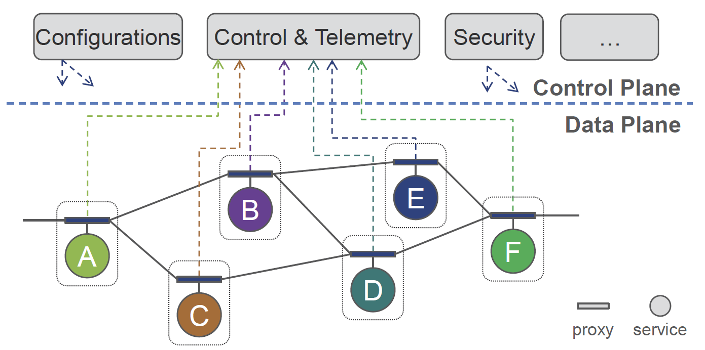
Architectural Overview of Service Mesh
A service mesh infrastructure logically consists of a data plane and a control plane.
The data plane is composed of a set of intelligent proxies, which are typically deployed as sidecars.
The control plane manages and configures the proxies for traffic routing.

Slide 8

Service Mesh Features
Service discovery
Typically, service instances are discovered by looking up a registry underneath which keeps records of new instances as well as instances that are removed from the network.
Load balancing
Fault tolerance
Traffic monitoring
Circuit breaking
Authentication and access control

Slide 9
Enablement Technologies
Istio
Linkerd
Airbnb Synapse
it solves the problem of automated failover through a simplistic but efficient, Zookeeperbased service discovery mechanism. In detail, Synapse configures a local HAProxy process using the information read from Zookeeper where states of the services are stored and continuously updated. By doing so, the local HAProxy can take care of properly routing the request from a service consumer. With an optimized HAProxy, Synapse can react to the change (e.g., service failure) in Zookeeper, and reconfigure HAProxy immediately.
Amazon App Mesh

Slide 10


Slide 11
Why Service Mesh?
Debugging microservices applications turns out to be a challenging task due to
the complexity of service dependencies and
the fact that any service can become temporarily inaccessible to its consumers
as the application behavior depends on the flow of the traffic among microservices, traffic control becomes a must (but currently missing) for runtime operation.

Slide 12
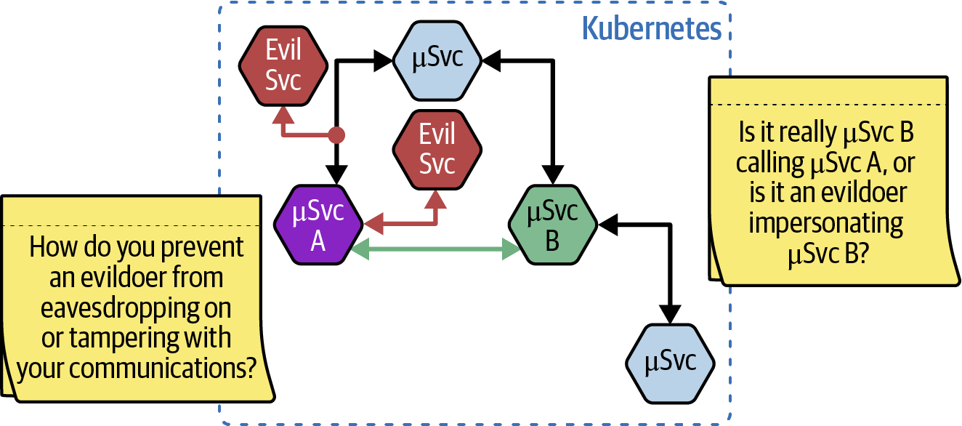
Security [3]

Slide 13
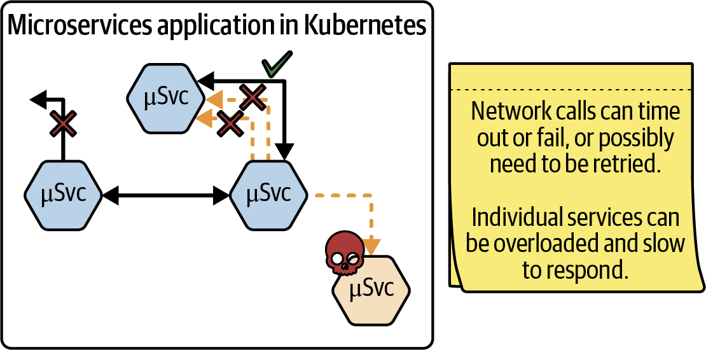
Reliability

Slide 14
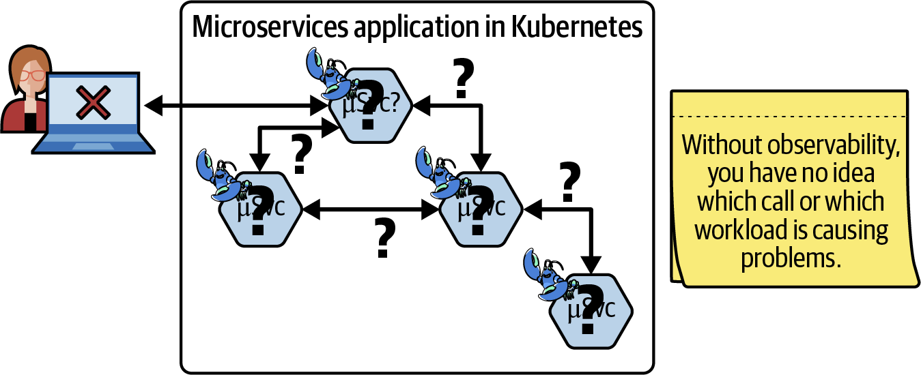
Observability

Slide 16
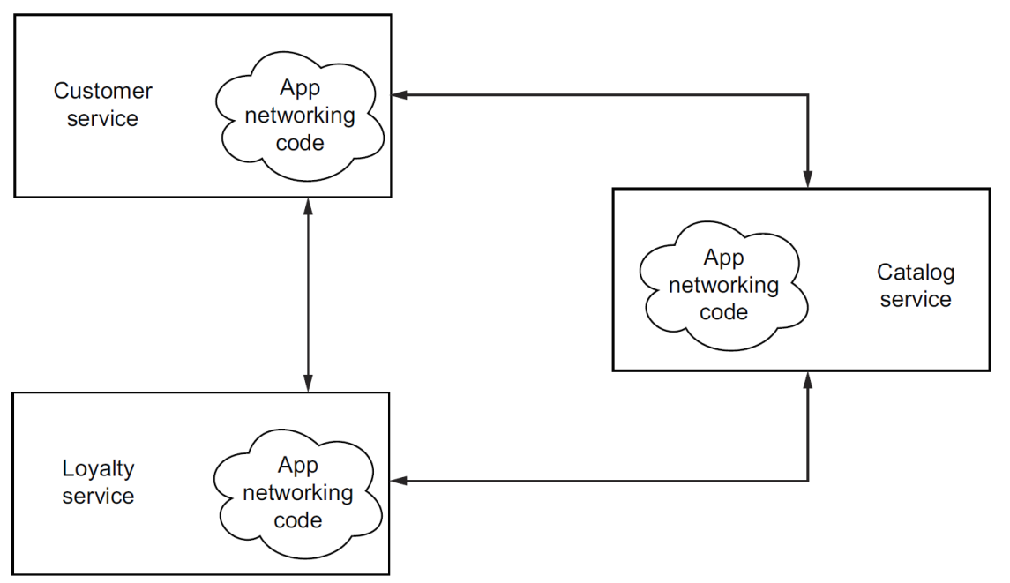
Application Networking Libraries [2]
Hystrix—Circuit breaking and bulkheading
Ribbon—Client-side load balancing
Eureka—Service registration and discovery
Zuul—Dynamic edge proxy
Application networking libraries commingled with an application.

Slide 17
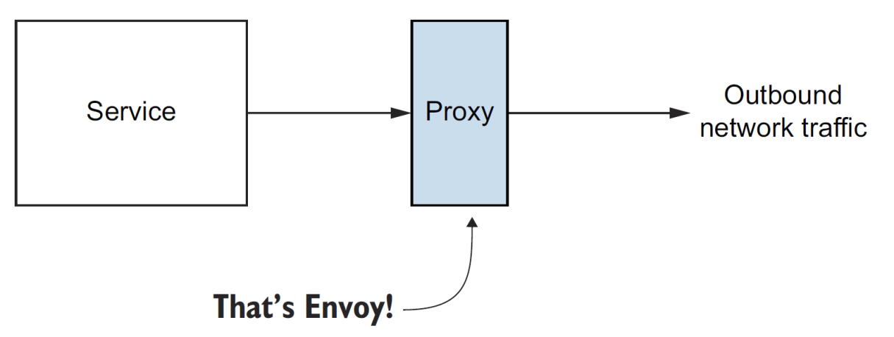
The Envoy proxy
The Envoy proxy is an out-of-process participant in application networking.
https://www.envoyproxy.io/

Slide 18
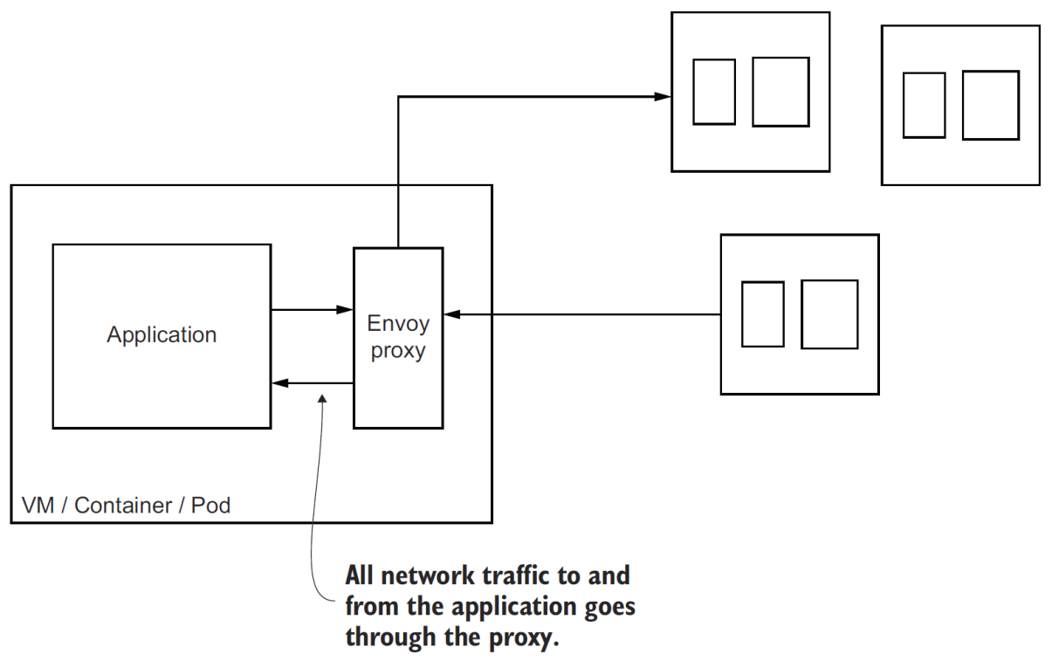
Service Proxies
We can deploy service proxies alongside our applications to get these features (resilience and observability) out-of-process from the application, but at a fidelity that is very application specific.

Slide 19
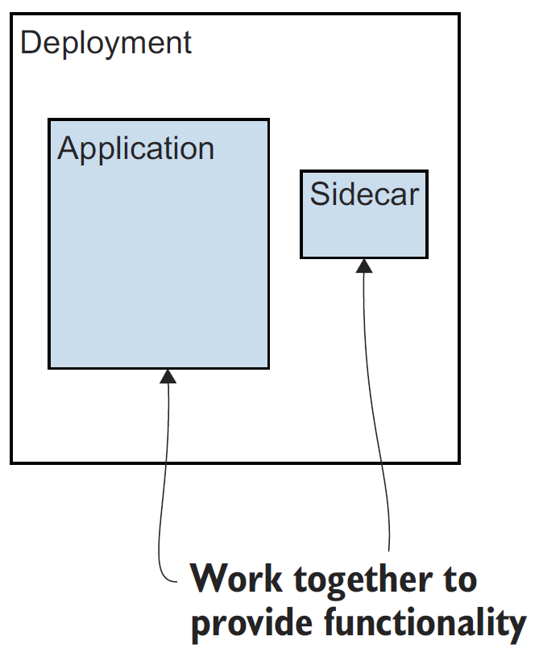
The sidecar deployment pattern
A sidecar deployment is an additional process that works cooperatively with the main application process to deliver a piece of functionality.

Slide 20
Istio
Istio is an open source implementation of a service mesh founded by Google, IBM, and Lyft.
Istio’s data plane uses the Envoy proxy and helps you configure your application to have an instance of the service proxy (Envoy) deployed alongside it.
Istio’s control plane is made up of a few components that provide APIs for end users/operators, configuration APIs for the proxies, security settings, policy declarations, and more.
You can use an Istio-based service mesh across deployment platforms like Kubernetes, OpenShift, and even traditional deployment environments like virtual machines (VMs).
Istio is Greek for “sail”.

Slide 21
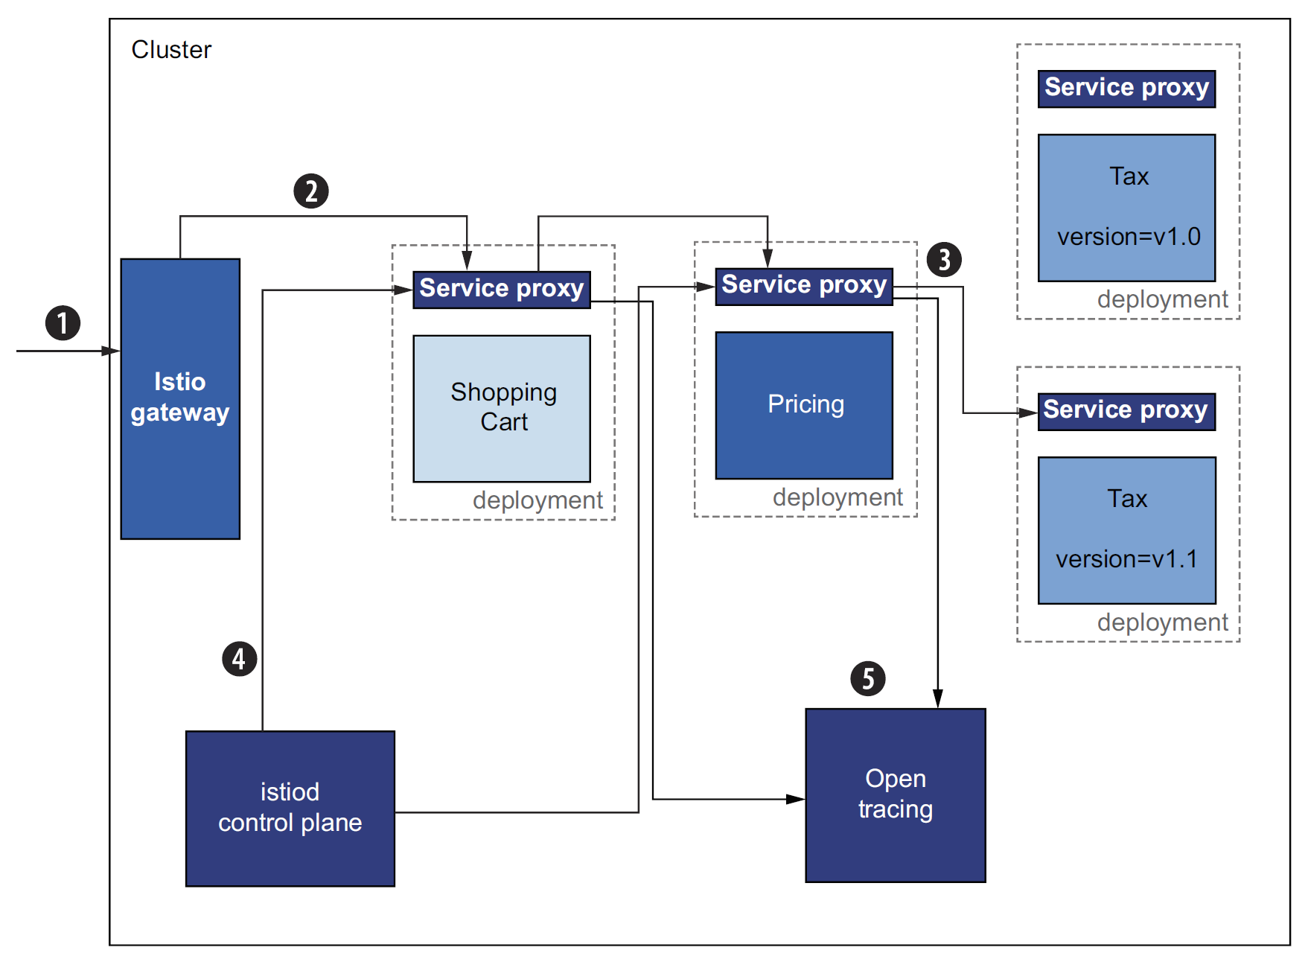
Istio's Architecture
Istio is an implementation of a service mesh with a data plane based on Envoy and a control plane.

Slide 22
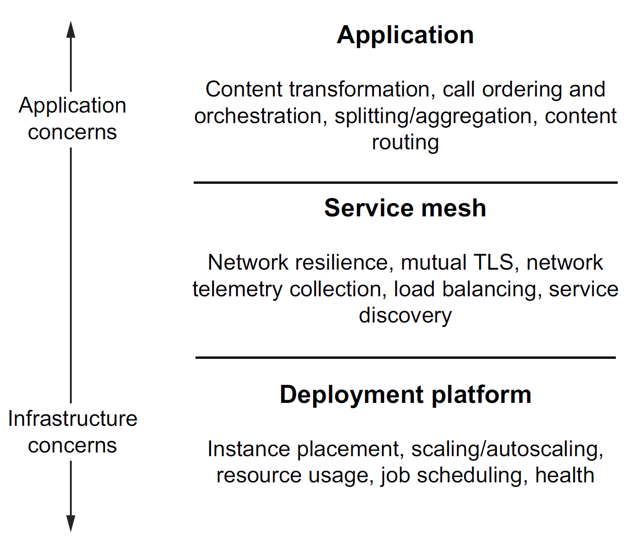
Separation of concerns
Istio plays a supporting role to the application layer and sits above the lower-level deployment layer.

Slide 24
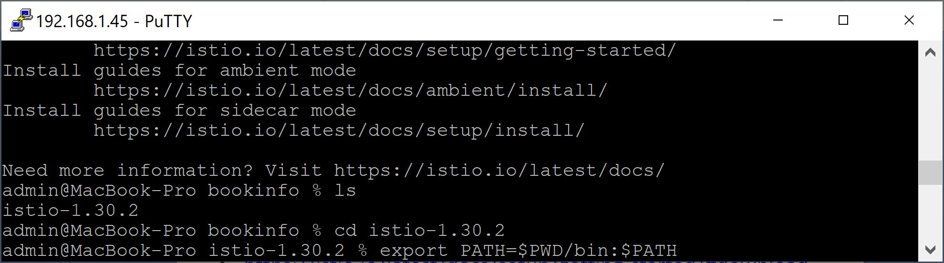
1. Download Istio on macOS
https://istio.io/latest/docs/setup/getting-started/#download
curl -L https://istio.io/downloadIstio | sh -
cd istio-1.30.2
export PATH=$PWD/bin:$PATH

Slide 25
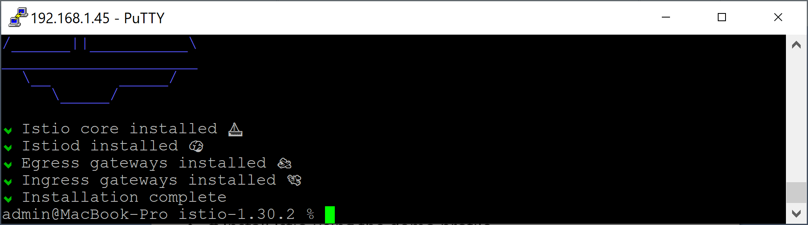
2. Install Istio
https://istio.io/latest/docs/setup/getting-started/
# Install Istio using the demo profile.
# Claude Code: What id Istio profile?
istioctl install --set profile=demo -y
# Add a namespace label to instruct Istio to automatically inject Envoy sidecar proxies when you deploy your application later:
kubectl label namespace default istio-injection=enabled

Slide 26
3. Install the Kubernetes Gateway API CRDs
# The Kubernetes Gateway API CRDs do not come installed by default on most Kubernetes clusters, so make sure they are installed before using the Gateway API.
kubectl get crd gateways.gateway.networking.k8s.io &> /dev/null || \
{ kubectl kustomize "github.com/kubernetes-sigs/gateway-api/config/crd?ref=v1.5.1" | kubectl apply -f -; }

Slide 27
4. Deploy the Bookinfo sample application
kubectl apply -f samples/bookinfo/platform/kube/bookinfo.yaml
kubectl get services
kubectl get pods
kubectl exec "$(kubectl get pod -l app=ratings -o jsonpath='{.items[0].metadata.name}')" -c ratings -- curl -sS productpage:9080/productpage | grep -o "<title>.*</title>"

Slide 28
5. Open the application to outside traffic
# Create a Kubernetes Gateway for the Bookinfo application:
kubectl apply -f samples/bookinfo/gateway-api/bookinfo-gateway.yaml
# Change the service type to ClusterIP by annotating the gateway:
kubectl annotate gateway bookinfo-gateway networking.istio.io/service-type=ClusterIP --namespace=default
# Check the status of the gateway:
kubectl get gateway

Slide 29
6. Access the application
kubectl port-forward --address 0.0.0.0 svc/bookinfo-gateway-istio 8080:80
http://192.168.1.45:8080/productpage

Slide 31
1. Install Istio for Online Boutique
# Restart the boutique so Envoy sidecars get injected (pods become 2/2):
kubectl rollout restart deployment -n default
kubectl get pods -n default
# Add the gateway route (ingress gateway -> frontend service).
kubectl apply -f istio-manifests/frontend-gateway.yaml
# Access via the ingress gateway
kubectl port-forward -n istio-system --address 0.0.0.0 svc/istio-ingressgateway 8081:80
# local: http://localhost:8081 | LAN: http://192.168.1.45:8081

Slide 32
2. Verify the Status of Istio Sidecars
# Once Istio sidecars are running, Prometheus scrapes their metrics.
kubectl port-forward -n monitoring svc/prometheus-server 9090:80
http://192.168.1.45:9090/query?g0.expr=sum%28rate%28istio_requests_total%5B5m%5D%29%29&g0.show_tree=0&g0.tab=graph&g0.range_input=1h&g0.res_type=auto&g0.res_density=medium&g0.display_mode=lines&g0.show_exemplars=0

Slide 33
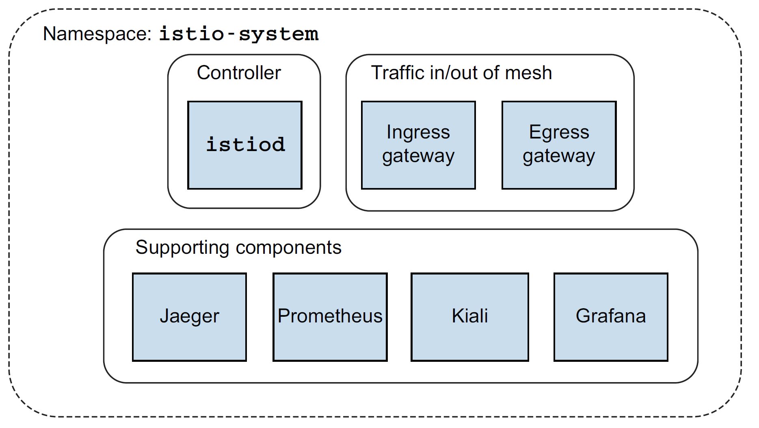
Istio control plane and supporting components

Slide 34
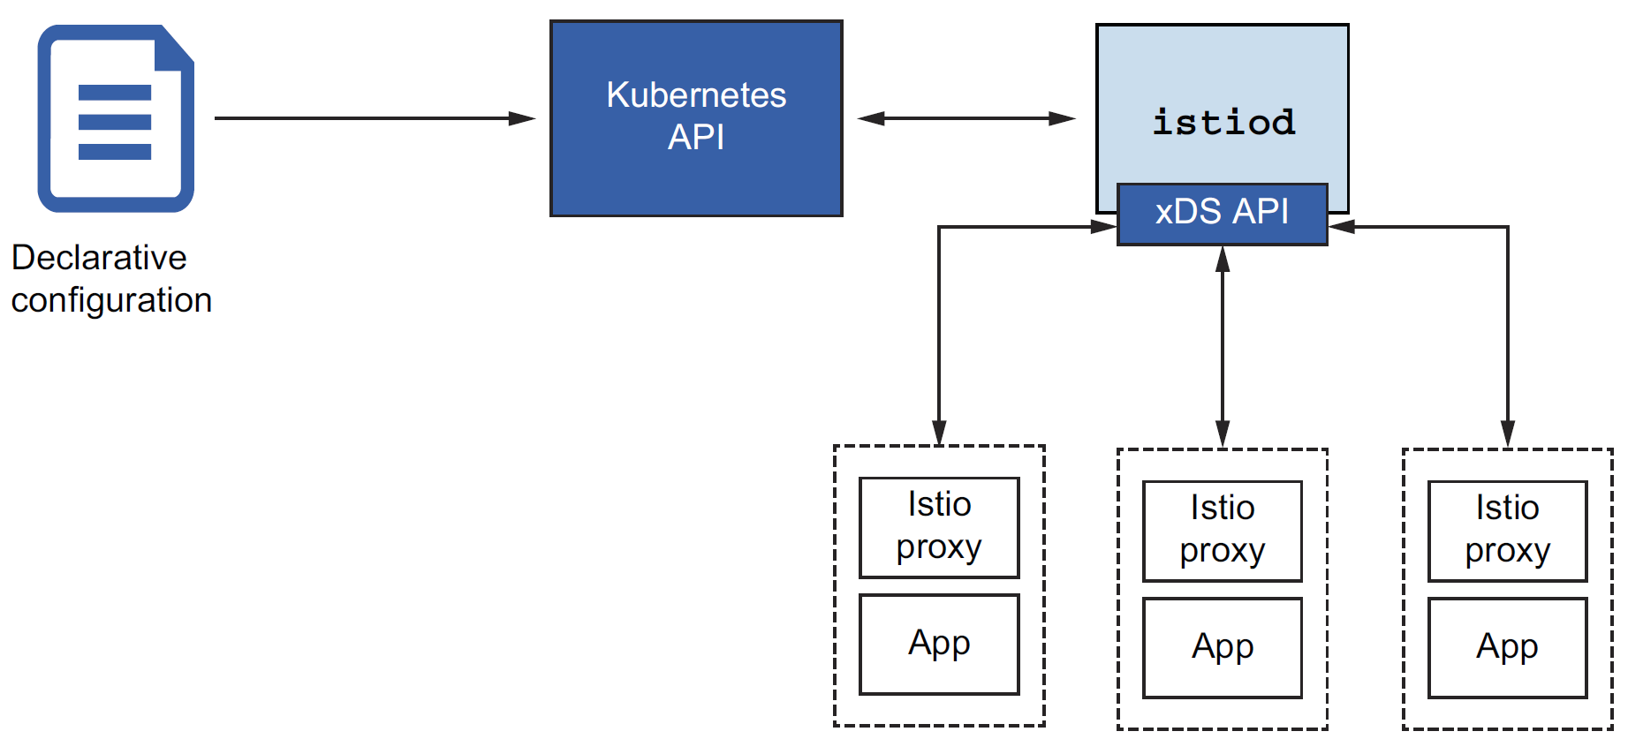
Istiod
Istio’s control-plane responsibilities are implemented in the istiod component.
istiod, sometimes referred to as Istio Pilot, is responsible for taking higher-level Istio configurations specified by the user/operator and turning them into proxy-specific configurations for each data-plane service proxy

Slide 35
Istio and Kubernetes
Istio uses Kubernetes custom resources when deployed on Kubernetes.
Istio’s configuration resources are implemented as Kubernetes custom resource definitions (CRDs).
CRDs are used to extend the native Kubernetes API to add new functionality to a Kubernetes cluster without having to modify any Kubernetes code.
In the case of Istio, we can use Istio’s custom resources (CRs) to add Istio functionality to a Kubernetes cluster and use native Kubernetes tools to apply, create, and delete the resources. Istio implements a controller that watches for these new CRs to be added and reacts to them accordingly.

Slide 37
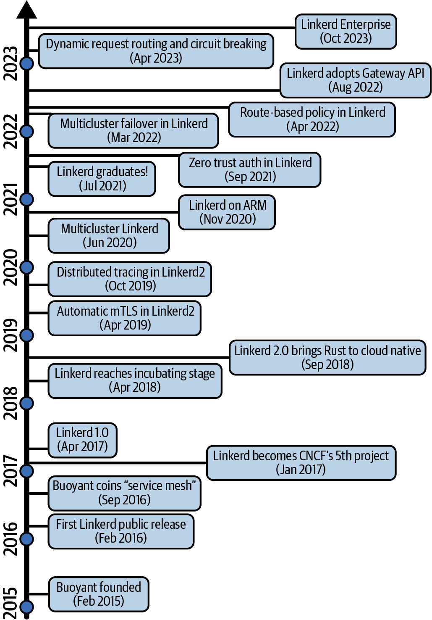
Intro to Linkerd [3]

Slide 38
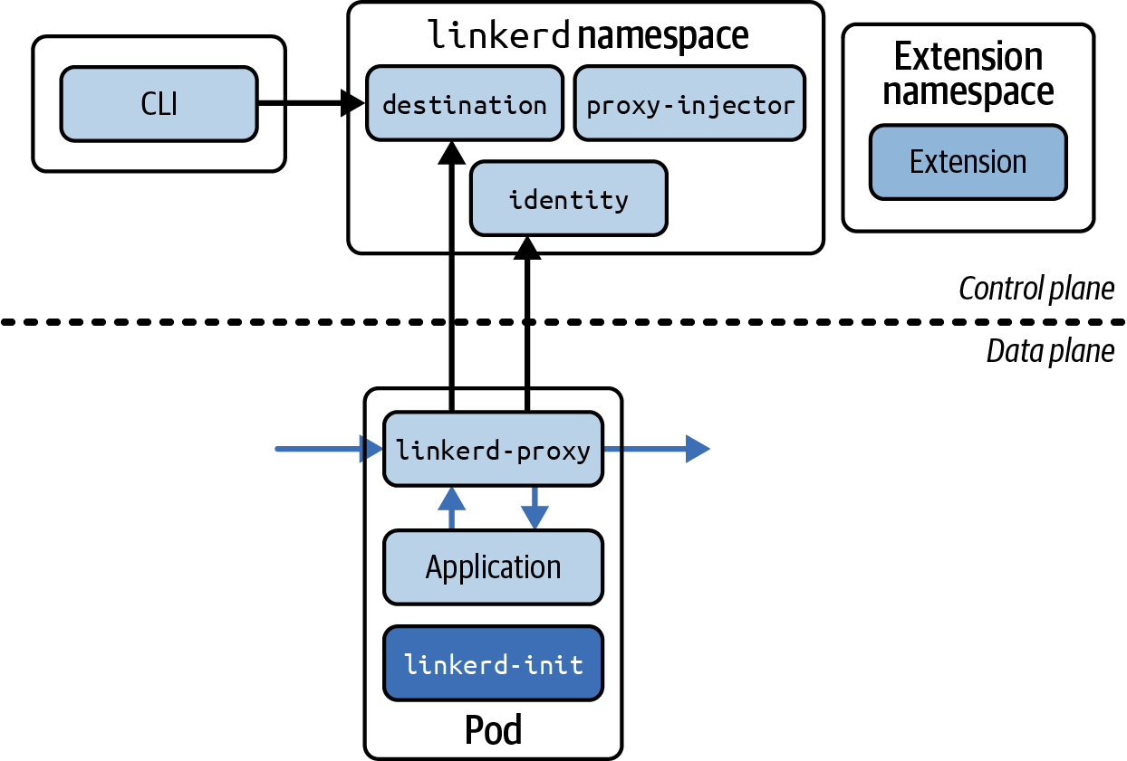
Linkerd Architecture

Slide 39
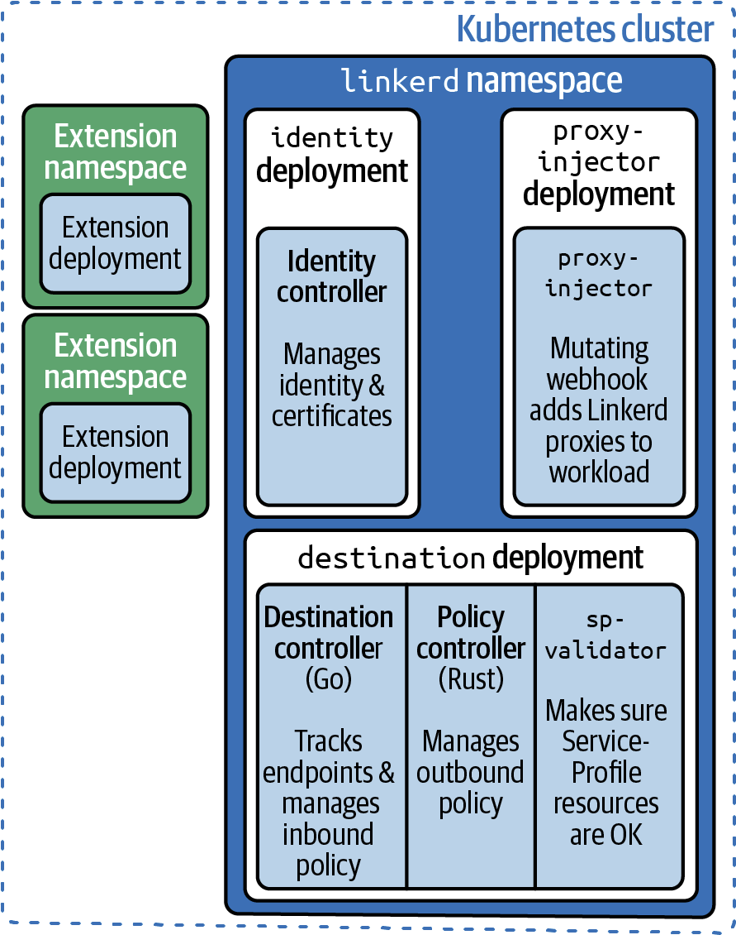
The Linkerd Control Plane

Slide 40
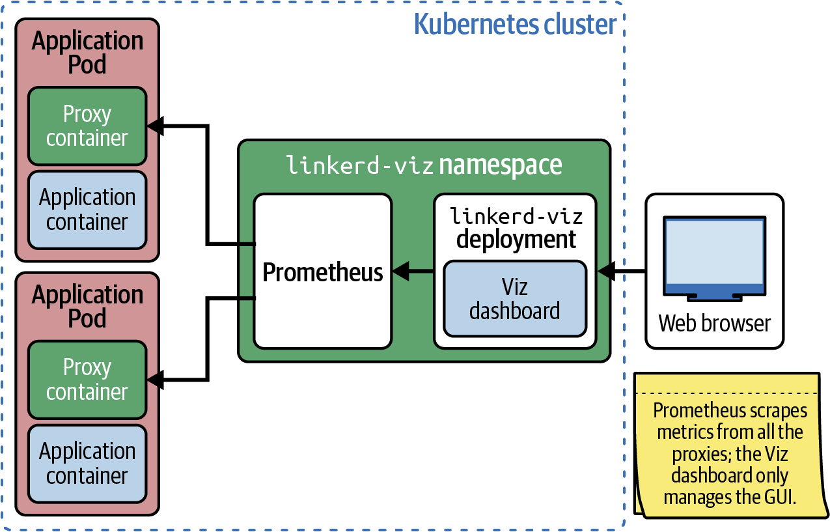
Linkerd Viz (Dashboard)

Slide 41
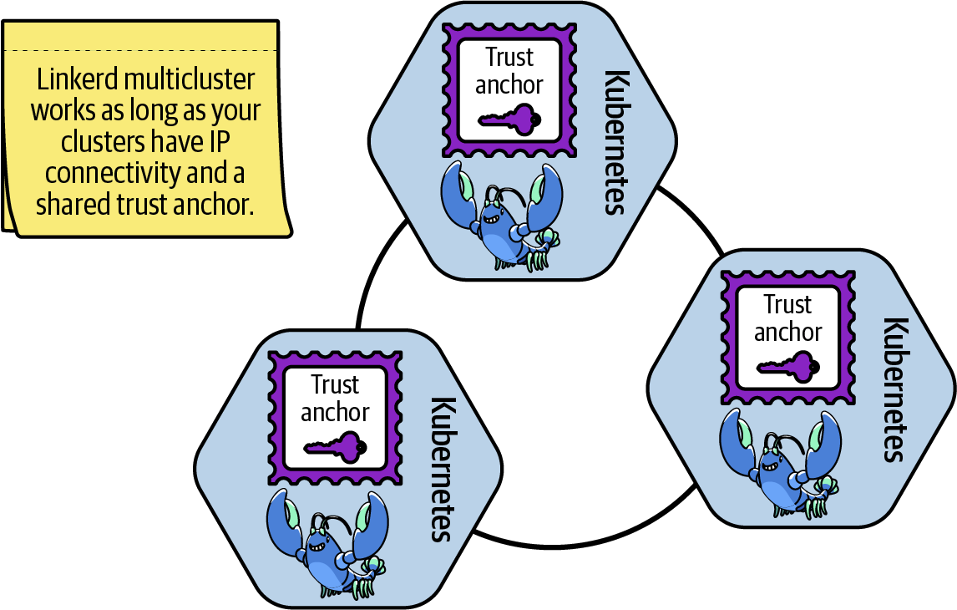
Linkerd Multicluster (Extension)

Slide 42
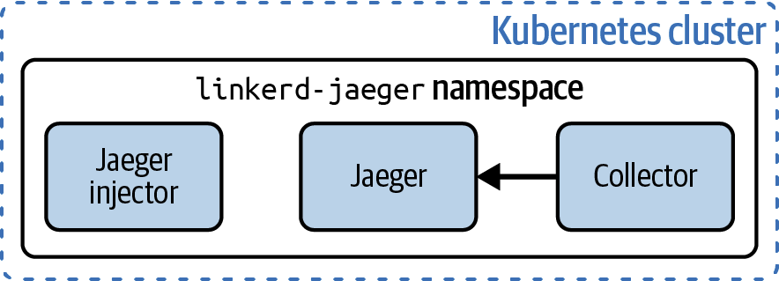
Linkerd Jaeger (Distributed Tracing)

Slide 44
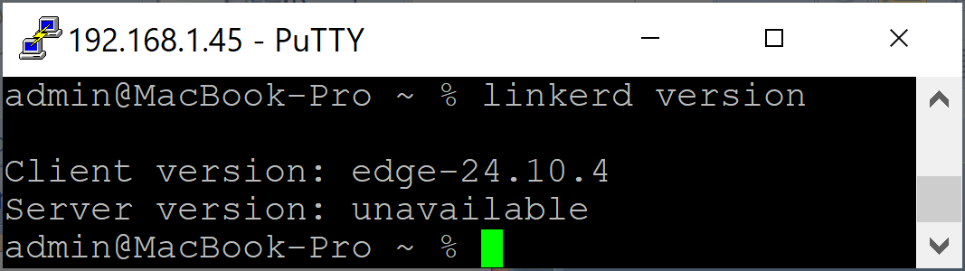
1. Install the linkerd CLI on macOS
https://linkerd.io/2.16/getting-started/
kubectl version
curl --proto '=https' --tlsv1.2 -sSfL https://run.linkerd.io/install-edge | sh
sudo nano /etc/paths
$HOME/.linkerd2/bin
linkerd version

Slide 45
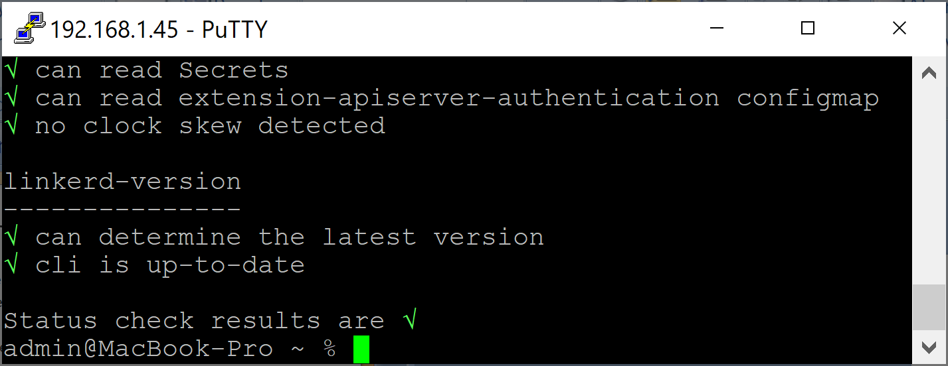
2. Create a k3d Cluster
k3d cluster create linkerd
kubectl get nodes
# validate that the cluster is configured correctly
linkerd check --pre

Slide 46
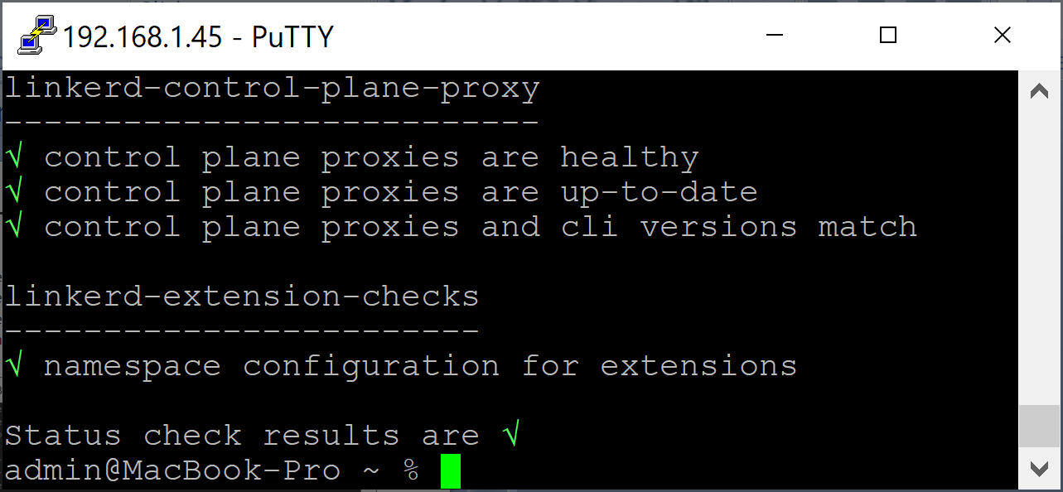
3. Install Linkerd via the CLI
# linkerd install will silently create certificates for you.
# This is OK for a demo, but not for production.
linkerd install --crds | kubectl apply -f -
linkerd install | kubectl apply -f -
linkerd check

Slide 47
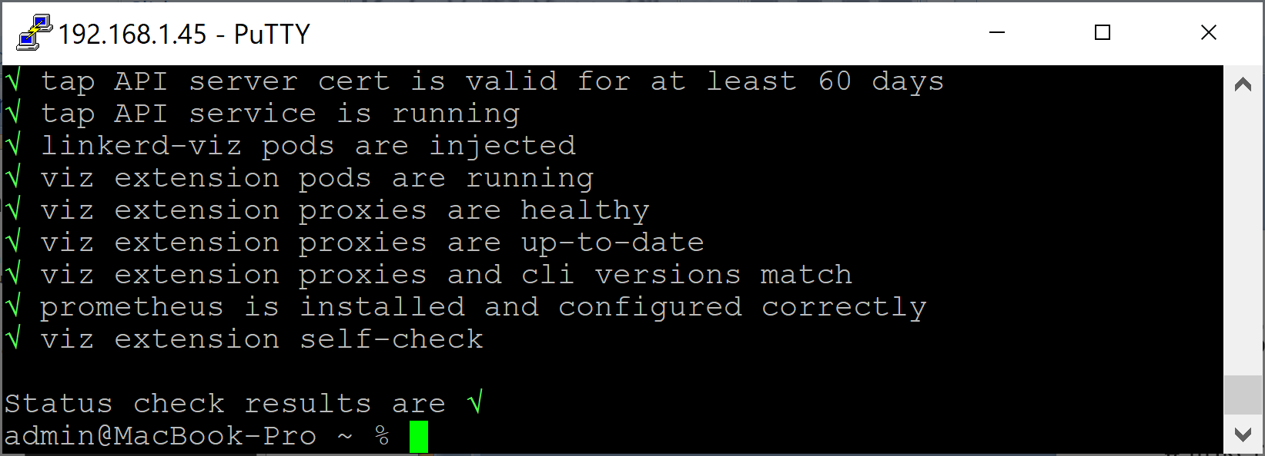
4. Install Linkerd Viz
linkerd viz install | kubectl apply -f -
linkerd check

Slide 48
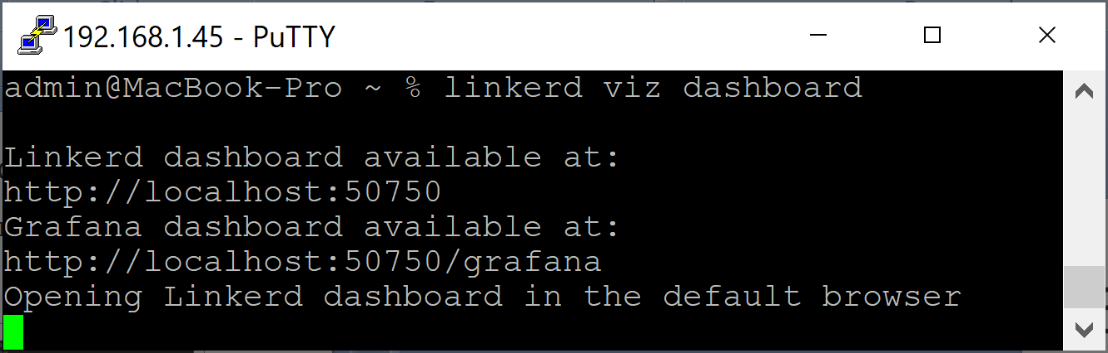
5. Open Linkerd Viz
linkerd viz dashboard

Slide 49
6. Uninstall Linkerd
https://linkerd.io/2-edge/tasks/uninstall/
linkerd viz uninstall | kubectl delete -f -
linkerd uninstall | kubectl delete -f -
# delete cluster.
k3d cluster delete linkerd

Slide 50
Opaque and Skip Ports
Opaque ports and skip ports are Linkerd names for ports to which special rules are applied.
An opaque port in Linkerd is a port that should be treated as a generic TCP connection. Linkerd will still use mTLS on opaque traffic.
A skip port is one that you instruct Linkerd to completely ignore.

Slide 51
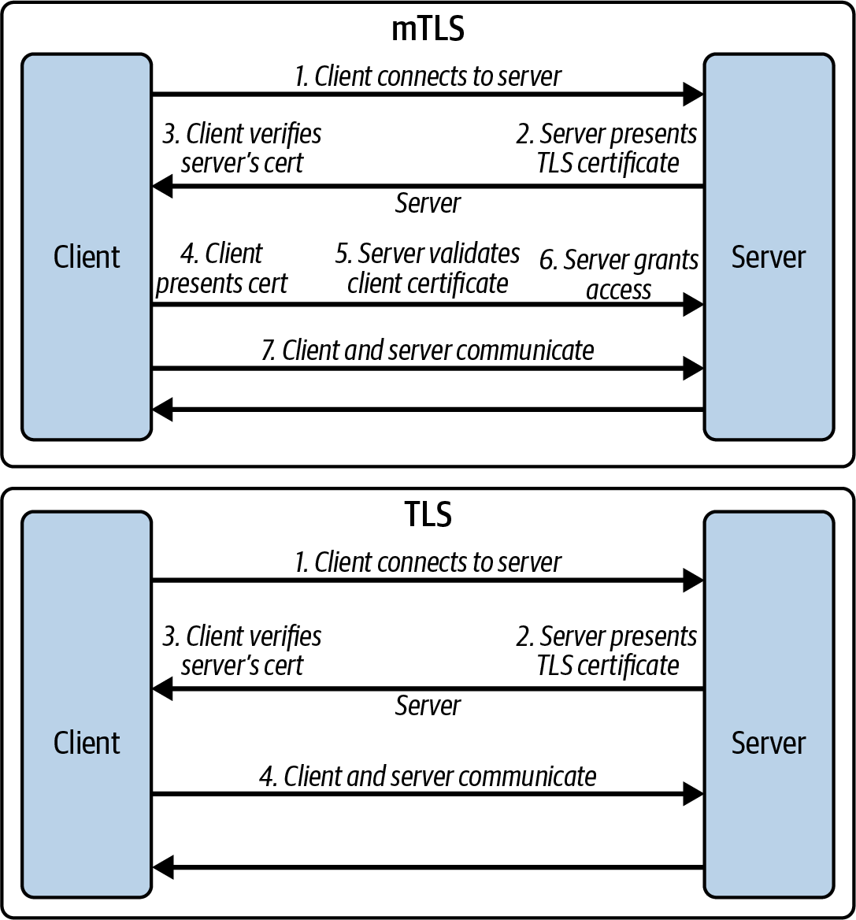
Mutual TLS
mTLS
Authenticate both ends of the connection.
Require both ends to send certificates for identification.
TLS: Only the receiver identifies itself.

Slide 53
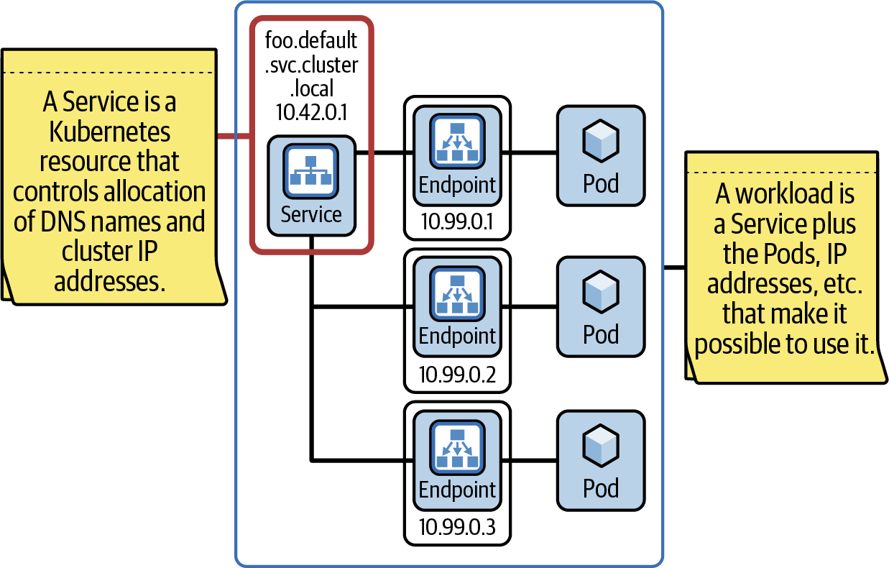
Workloads

Slide 54
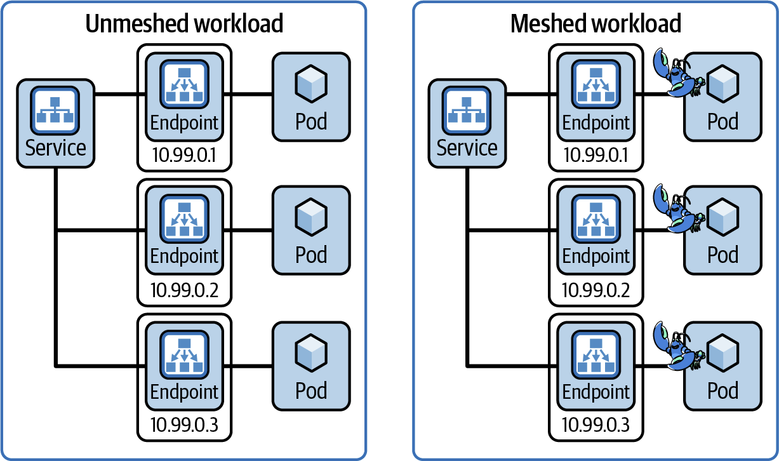
Adding a workload to the mesh
Adding the Linkerd sidecar to each of your workload’s Pods.

Slide 55
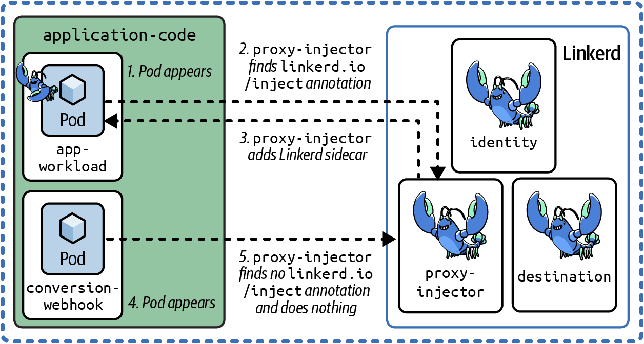
The proxy injector
Linkerd includes a Kubernetes admission controller called the linkerd-proxy-injector.
Its job, unsurprisingly, is to inject Linkerd proxies into workload Pods.
Of course, it doesn’t do this blindly; instead, it looks for Kubernetes annotations that tell it which Pods need to be injected.

Slide 56
1. Install the demo app
# Install Emojivoto into the emojivoto namespace:
curl --proto '=https' --tlsv1.2 -sSfL https://run.linkerd.io/emojivoto.yml | kubectl apply -f -
kubectl -n emojivoto port-forward svc/web-svc 8080:80
# Now visit http://localhost:8080

Slide 57
2. Add Linkerd’s data plane proxies
# This command retrieves all of the deployments running in the emojivoto namespace, runs their manifests through linkerd inject, and then reapplies it to the cluster.
kubectl get -n emojivoto deploy -o yaml | linkerd inject - | kubectl apply -f -
linkerd -n emojivoto check --proxy
kubectl -n emojivoto port-forward svc/web-svc 8080:80

Slide 58
3. Explore Linkerd
linkerd viz dashboard &
# Review Namespaces > emojivoto

Slide 60
.NET Example
https://dotnetfullstackdev.medium.com/service-mesh-with-linkerd-in-a-net-microservice-architecture-e87d3d406b06

Slide 62
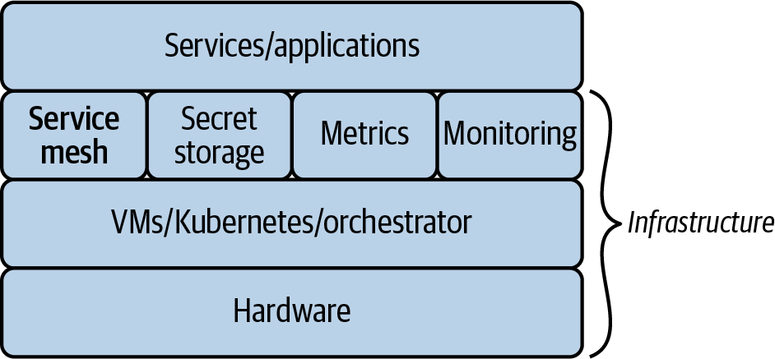
A typical software stack [4]

Slide 63
Sidecar Proxies
A proxy is an application that traffic is routed through on the way to its destination.
Popular proxies you may have heard of are NGINX, HAProxy, and Envoy.
In most service meshes, all service traffic (inbound and outbound) is routed through a local proxy dedicated to each service instance.
Each instance of a service must be deployed with its own local proxy.
The pattern of deploying a helper application—in this case a proxy—alongside the main service is known as the sidecar pattern, and so local proxies are referred to as sidecar proxies.

Slide 64
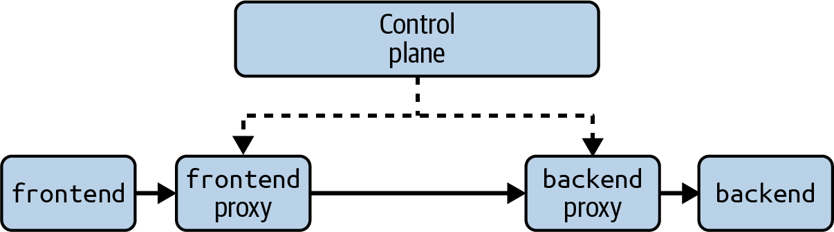
Control Plane
The control plane’s job is to manage and configure the sidecar proxies.
The control plane is where most of the complex logic of the service mesh lives: it must watch for services starting and stopping, sign and distribute certificates, reconfigure proxies, etc.
The sidecar proxies themselves are relatively simple: they receive configuration from the control plane detailing which actions to perform on traffic, and they perform those actions.

Slide 65
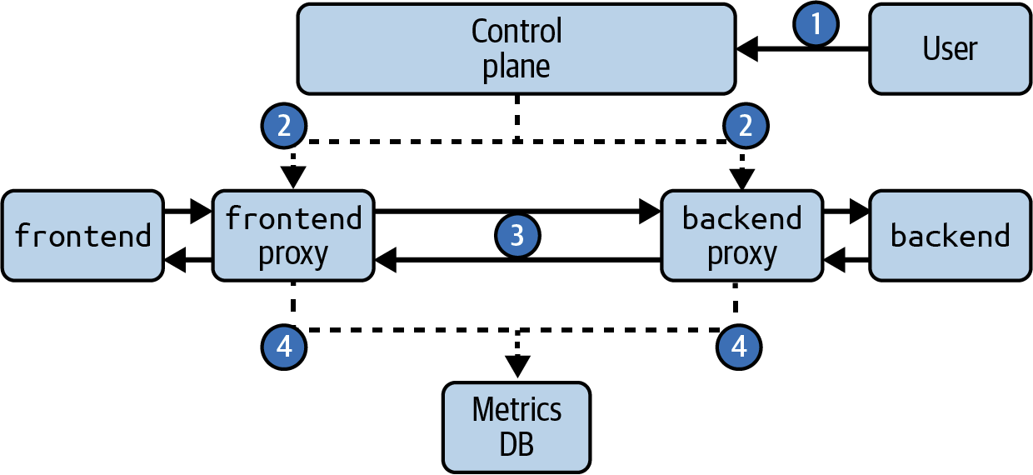
How a Service Mesh Works

Slide 66
Why Use a Service Mesh
A service mesh provides features in four areas: security, observability, reliability, and traffic control.
The fundamental value proposition of a service mesh is the ability to provide these features across every service and workload without modifying service code.

Slide 67
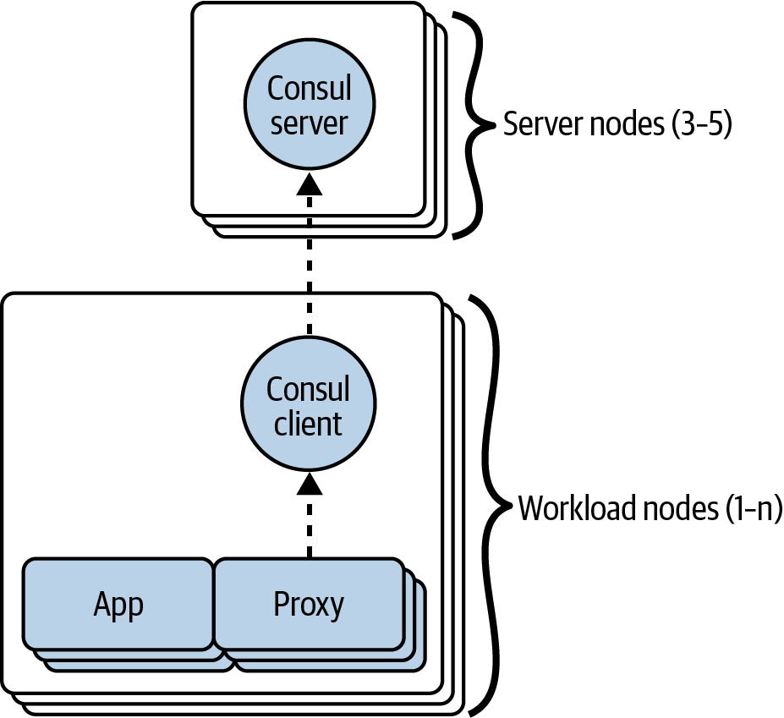
Consul Architecture

Slide 68
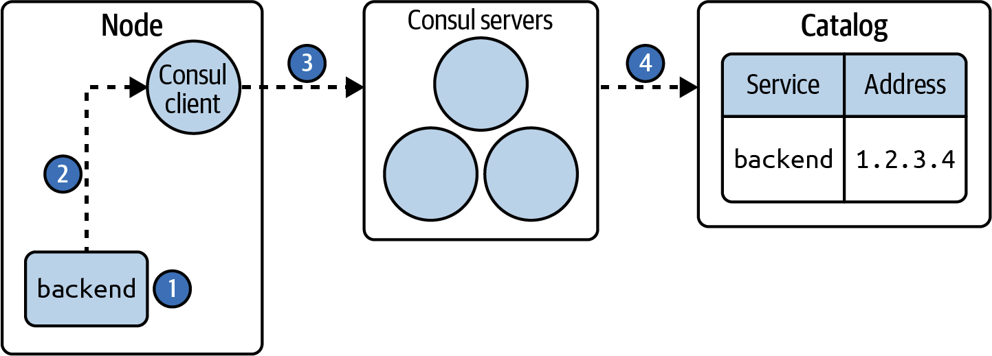
1. A new service being started on a node
The backend service is registered with its IP address—for example, 1.2.3.4— onto the Consul client on that node.

Slide 69
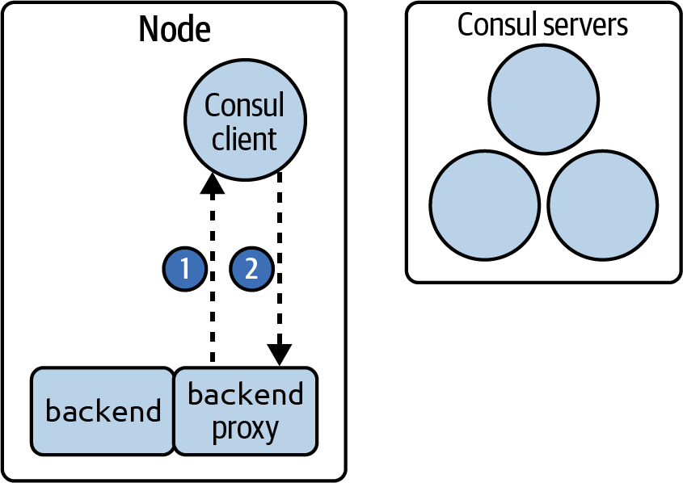
2. Consul client configuring the backend proxy
The Consul client configures the proxy and keeps the connection open for future reconfiguration.

Slide 70
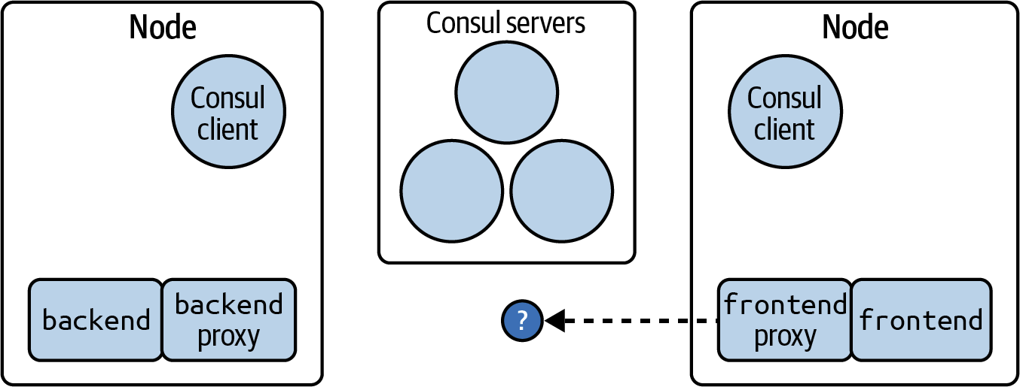
3. Frontend service is configured to talk to the backend service
Frontend service is configured to talk to the backend service, but it doesn’t yet know which address to use.

Slide 71
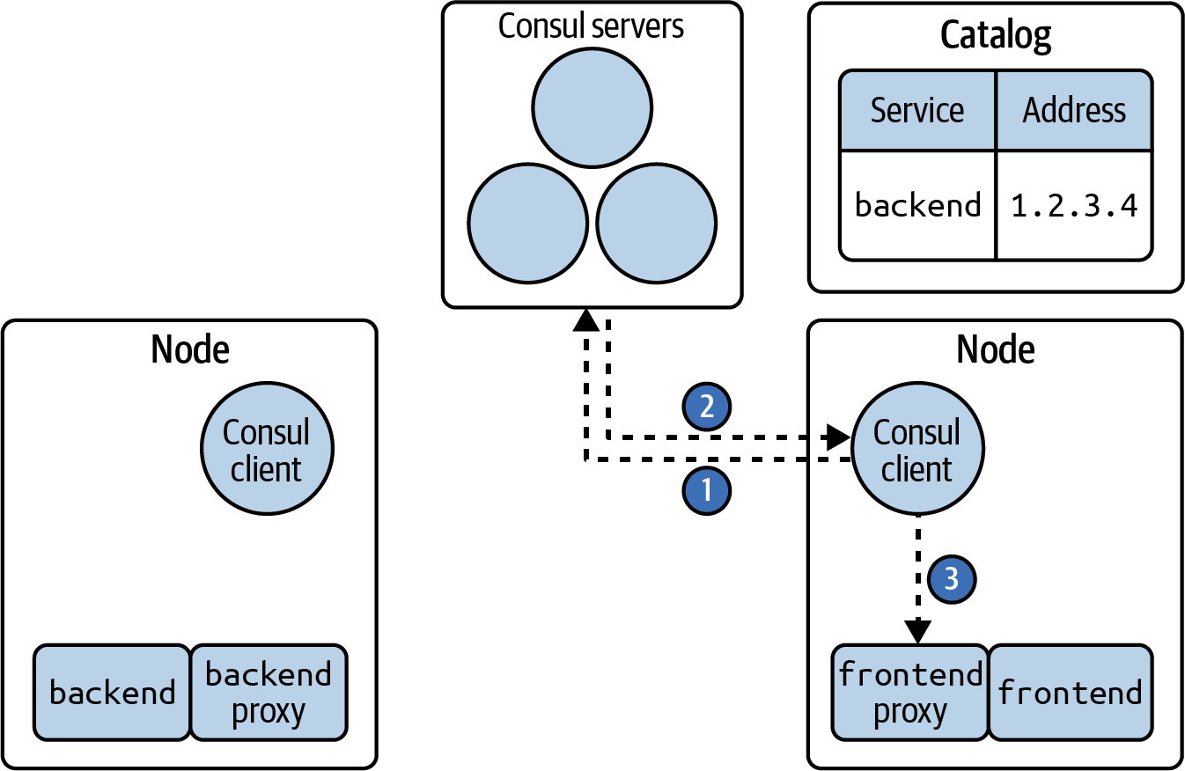
4. The frontend’s proxy learning the address of the backend service
The frontend’s proxy learning the address of the backend service in order to make a request.

Slide 72
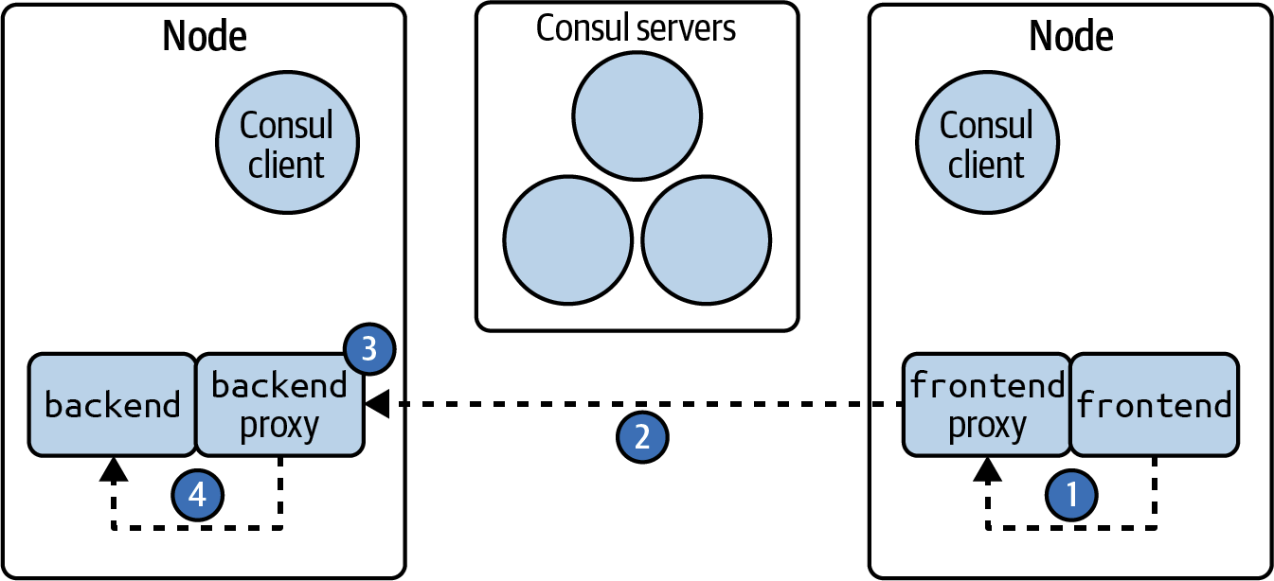
5. Sidecar proxies capture inbound and outbound traffic
Sidecar proxies capture inbound and outbound traffic and follow their configured rules to act on that traffic.

Slide 73
Consul Versus Other Meshes
There are many other service meshes in the marketplace, such as Istio and Linkerd.
Most services meshes follow the same general architecture with a control plane that manages sidecar proxies.
Consul is unique among other meshes in that its control plane can run entirely separate from Kubernetes.
This means if you’re managing a VM cluster that you don’t need to also run Kubernetes.

Slide 74

Thank You & See You Again

